Slide 1
Weather App
A Responsive Weather Application Built with React
Presented By :- Pranay Dhanke
Internship ID: UMIP14496

Slide 2
About Project

Slide 3
Overview
It is a modern and responsive weather application designed to provide accurate and up-to-date weather information for locations around the world. Built with the latest web technologies, our app leverages the power of React for a seamless user experience, the OpenWeatherMap API for reliable weather data
Project Link - https://whetherapp-three.vercel.app/
GitHub Link - https://github.com/PranayDhanke/e-panchayat.git

Slide 4
Key Features
Responsive Design: Our app is optimized for all screen sizes, ensuring a consistent and intuitive user experience on desktops, tablets, and mobile devices.
Current Weather Information: Get real-time weather updates, including temperature, humidity, wind speed, and more.

Slide 5
Technologies Used
React: A powerful JavaScript library for building dynamic user interfaces.
OpenWeatherMap API: A trusted source for real-time weather data.
React Toastify: A library for elegant and customizable toast notifications.
CSS: For responsive and attractive styling.

Slide 6
How It Works
Search for a City: Enter the name of a city in the search bar to retrieve the current weather information for that location.
View Weather Details: The app displays detailed weather information, including temperature, humidity, wind speed, and weather conditions.
Responsive Layout: Enjoy a seamless experience whether you're on a desktop, tablet, or mobile device, thanks to our responsive design

Slide 7
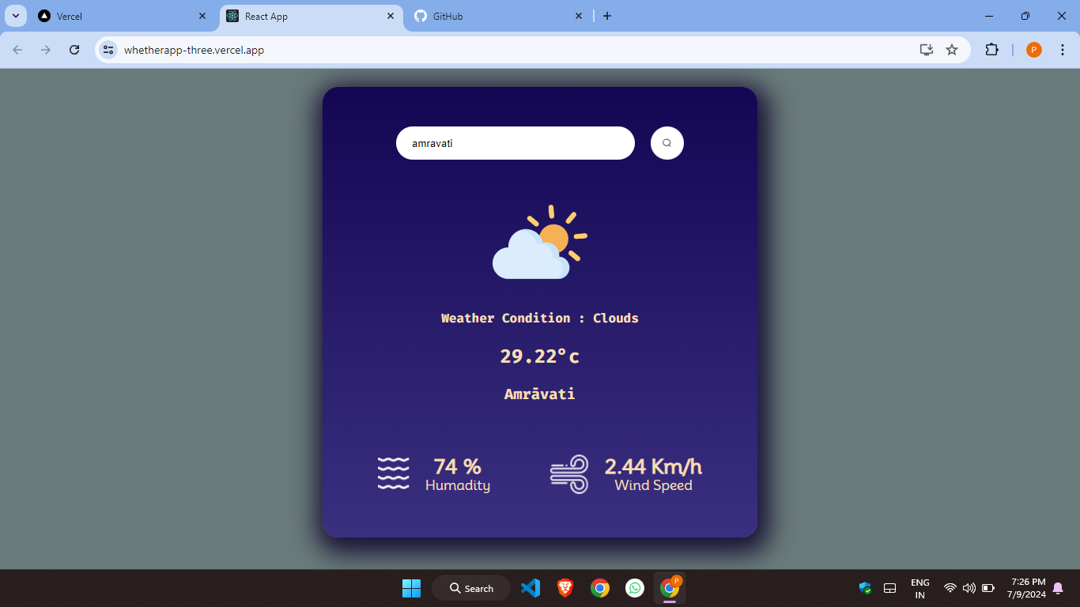
System Snapshots
City is available at weather API

Slide 8
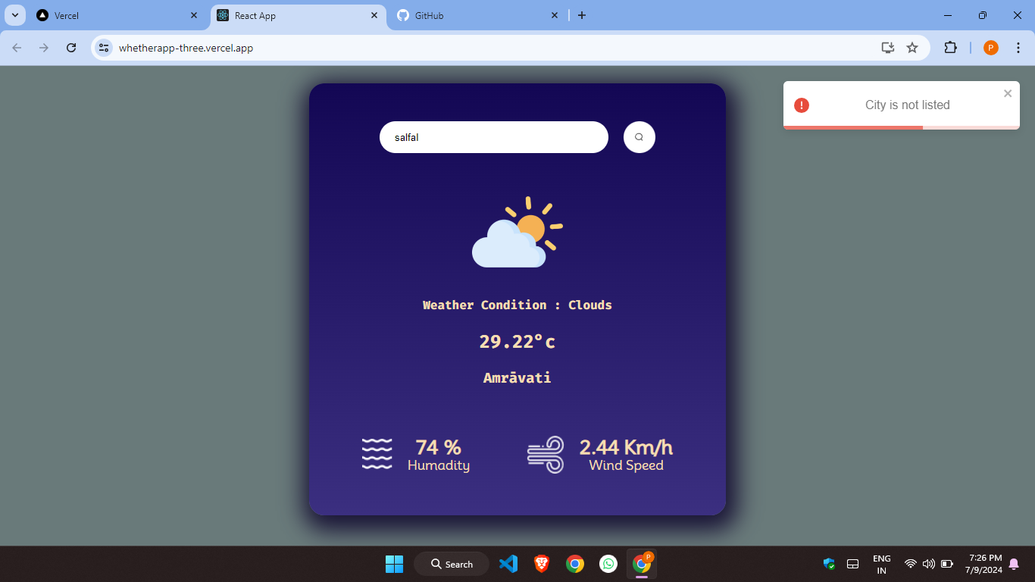
City is not available at weather API

Slide 9
Thank You

